Slide 1

MANGALORE INSTITUTE OF TECHNOLOGY AND ENGINEERING
A project on
“ COUNTER BRAKES ”
Under the guidance of
MR. SATHISHA
Associate Professor,Dept. of E&C Engineering
MITE
Team members
Adarsh S Achar (4MT17EC400) Shilpa J (4MT16EC081)
Dheeraj (4MT17EC404) Makaranda Prabhu (4MT17EC406)

Slide 2
ABSTRACT
Brakes can fail at any point in time, the most common cause of failure is a leak in the brake lines. The brake fluid will slowly drain out, until there isn’t enough left to transmit the pressure from the pedal to the tires
To minimize this we will detect the break failure with sensors and when detected the microcontroller is used as a decision-making device where vehicle speed is controlled through certain mechanism and the hand brake is pulled manually to stop the vehicle.
INTRODUCTION
We may not think about them very often, but we put a lot of trust in our brakes. Cars are inherently dangerous and our brakes are one of the first lines of defense against accidents.
We came up with idea to reduce accidents due to break failures

Slide 3
PROBLEM STATEMENT
A brake is a mechanical device that inhibits motion by slowing down a body or an object. Brakes retard the motion of a body creating friction between two working surfaces and convert the kinetic energy of the moving body into heat.
Sometimes brake failure may occur when the brake lining is cut-off. Most brakes commonly use friction between two surfaces pressed together to convert the kinetic energy of the moving object into heat, though other methods of energy conversion may be employed
Brake failure occurs only because of worn out of brake shoe and cut in liner. This system provides audio and visual alert when the brake failure occurs and speed of the vehicle is controlled by controlling the induction motor in case of electric vehicles or by passing the control to the gear box, which in reduces the speed of the vehicle in case of normal vehicles.

Slide 4
LITERATURE SURVEY
M. Grandone, M. Naddeo, D. Marra, G. Rizzo-2019[1]: A model able to estimate the vehicle braking torque, considering aerodynamics, vehicle friction and engine passive losses in different gears, has been developed and identified over road tests, for a vehicle hybridized with wheel motors on rear wheels.
Daniel Fenyes , Balazs Nemeth , Peter Gaspar-2019[2]: The paper has presented a new application of decision trees in autonomous vehicle control design.
Akilan . M, Austin Ashley .S, Elayarajan.B ,Manikandan. M, Kalidas. K-2018[3]: The project makes its impact in reducing the accidents due to brake failure. Most of the accidents can be reduced by using the system effectively.

Slide 5
G.VENKATA SIVA, Dr.B.CHANDRA MOHAN REDDY-2018 [4]: The main purpose of this paper is to provide such a device to vehicles operator so that any harmful damage and accidents caused by failure of brake can be easily prevented by the proper indication of working condition of brake.
D. Zhu, X. Wang, Y. Li and Y. Wang-2017 [5]:This study is based on the requirements of the road vehicle functional safety standards of ISO26262 and conducting hazard analysis and risk assessment to braking energy feedback of pure electric vehicle, so effectively limit bad brake to keep the vehicle in a safe condition when Energy regenerative braking failure occurs.
Radhakishan Maske, Satesh Surwase, Balbhim Moharir, Vrushabh Mahajan,Vijay Kedar, Prof.Amol Adkine-2017 [6]: Auxiliary braking gives additional capability to the driver and to ensure prevention of damage to life and property. The project give more confidence that we will be able to apply in practice, whatever theoretical knowledge.

Slide 6
Pandit Biradar, Jitendra Baravkar, Komal Bhujbal, Avi Bhapkar-2016 [7]: The aim of this work is to create a better braking system with indicator. Brake failure occurs only because of worn out of brake shoe and cut in liner.
Sungyeon Ko1 Chulho Song,JeongmanPark, Jiweon KoInbeom Yang2,Hyunsoo Kim 2013[8]: In-wheel motor torque control showed better performance with a smaller slip ratio and a shorter braking distance compared with the ABS.
K. Sundareswaran, P.Sankar, and P.Srinivasa Rao Nayak-2012 [9]: This paper has focused on the possible dynamic braking of AC voltage controller fed variable speed capacitor-run motors. It was proposed to run the machine with AC voltage controller for variable speed operation and then the power converter operation is modified to result half controlled operation, which was expected to cause dynamic braking.

Slide 7
METHODOLOGY
Block Diagram of Project:-
ADXL 335
Accelerometer
STM MICROCONTROLLER
LCD
DISPLAY
MOTOR
DRIVER
GEARED
DC
MOTOR
BRA KE
PEDAL
12V DC ADAPTER

Slide 8
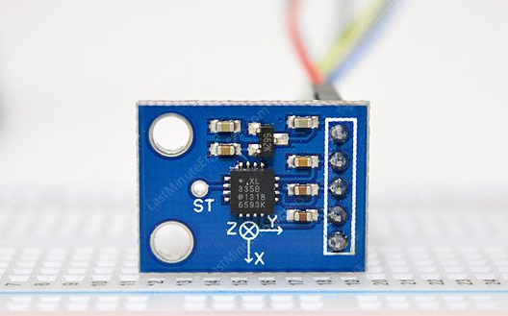
HARDWARE COMPONENTS USED
ADXL 335 ACCELEROMETER

Slide 9
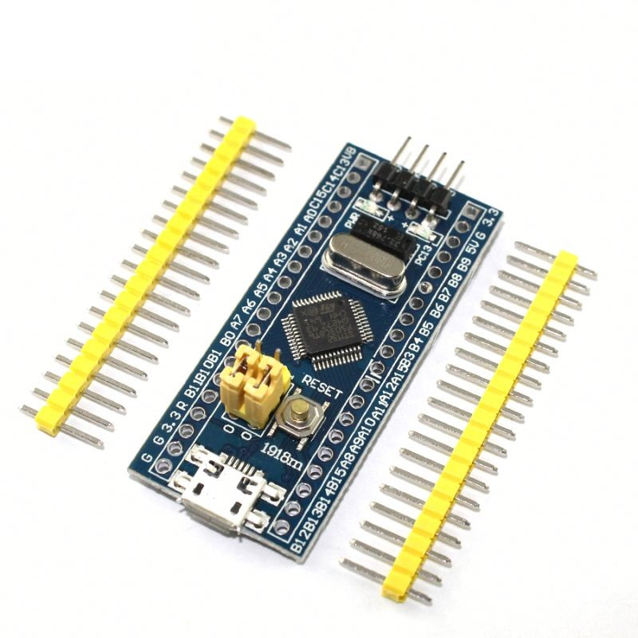
STM32 Microcontroller
Architecture: 32-bit ARM CortexM3
Operating Voltage: 2.7V to 3.6V
CPU Frequency: 72 MHz
Number of GPIO pins: 37
Number of PWM pins: 12
Analog input Pins: 10 (12-bit)

Slide 10
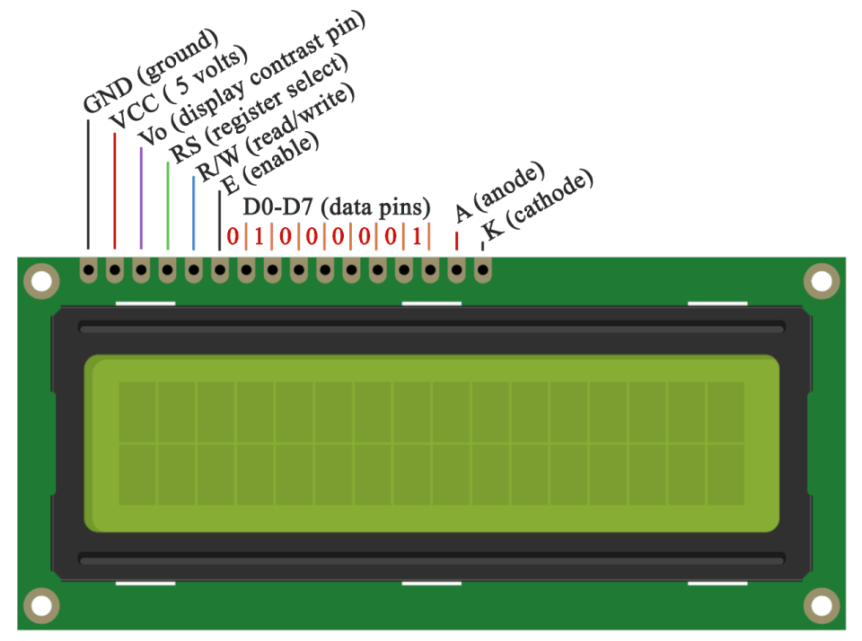
LCD DISPLAY

Slide 11
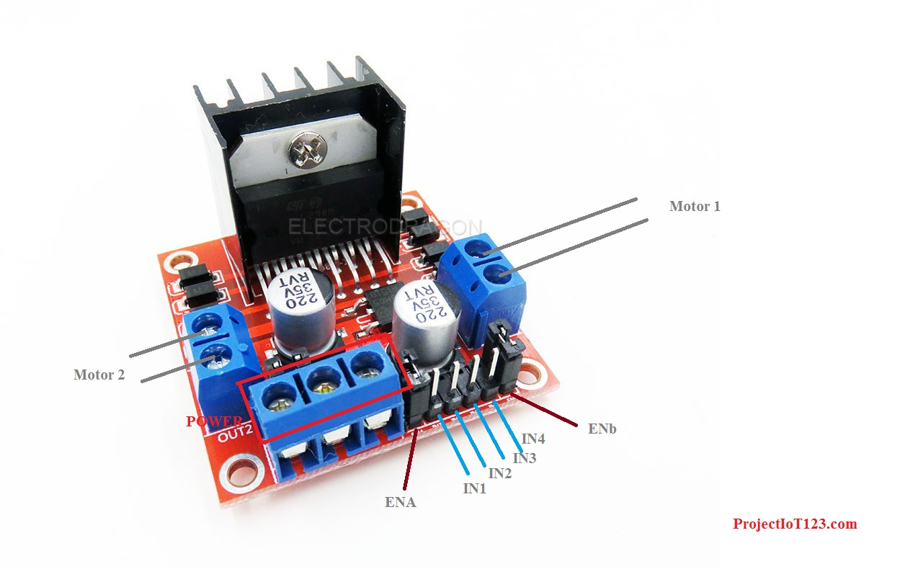
L298 MOTOR DRIVER

Slide 12
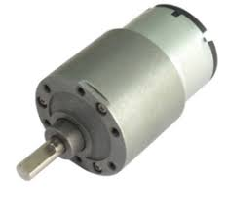
GEARED DC MOTOR

Slide 13
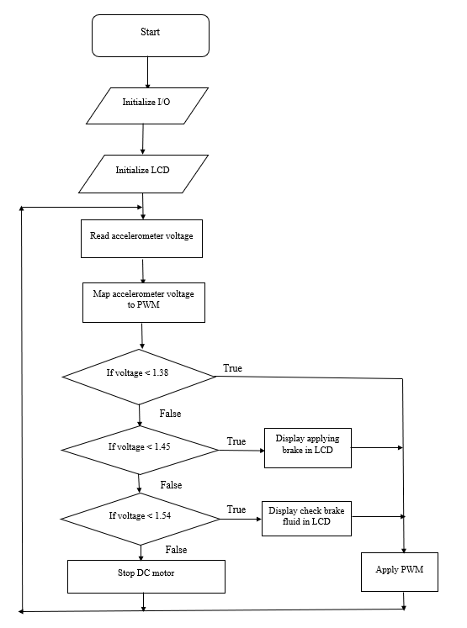
FLOW CHART OF THE PROJECT

Slide 14
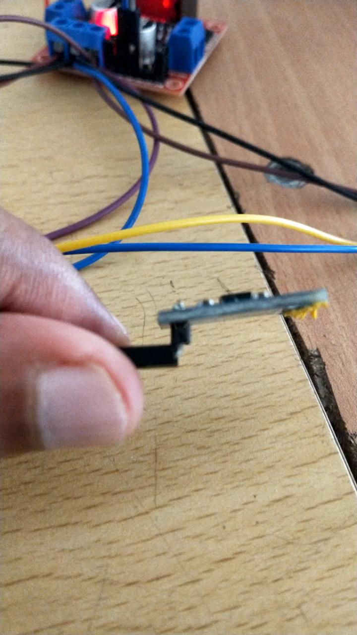
DIRECTION OF ACCELEROMETER USED UNDER BRAKE PEDAL

Slide 15
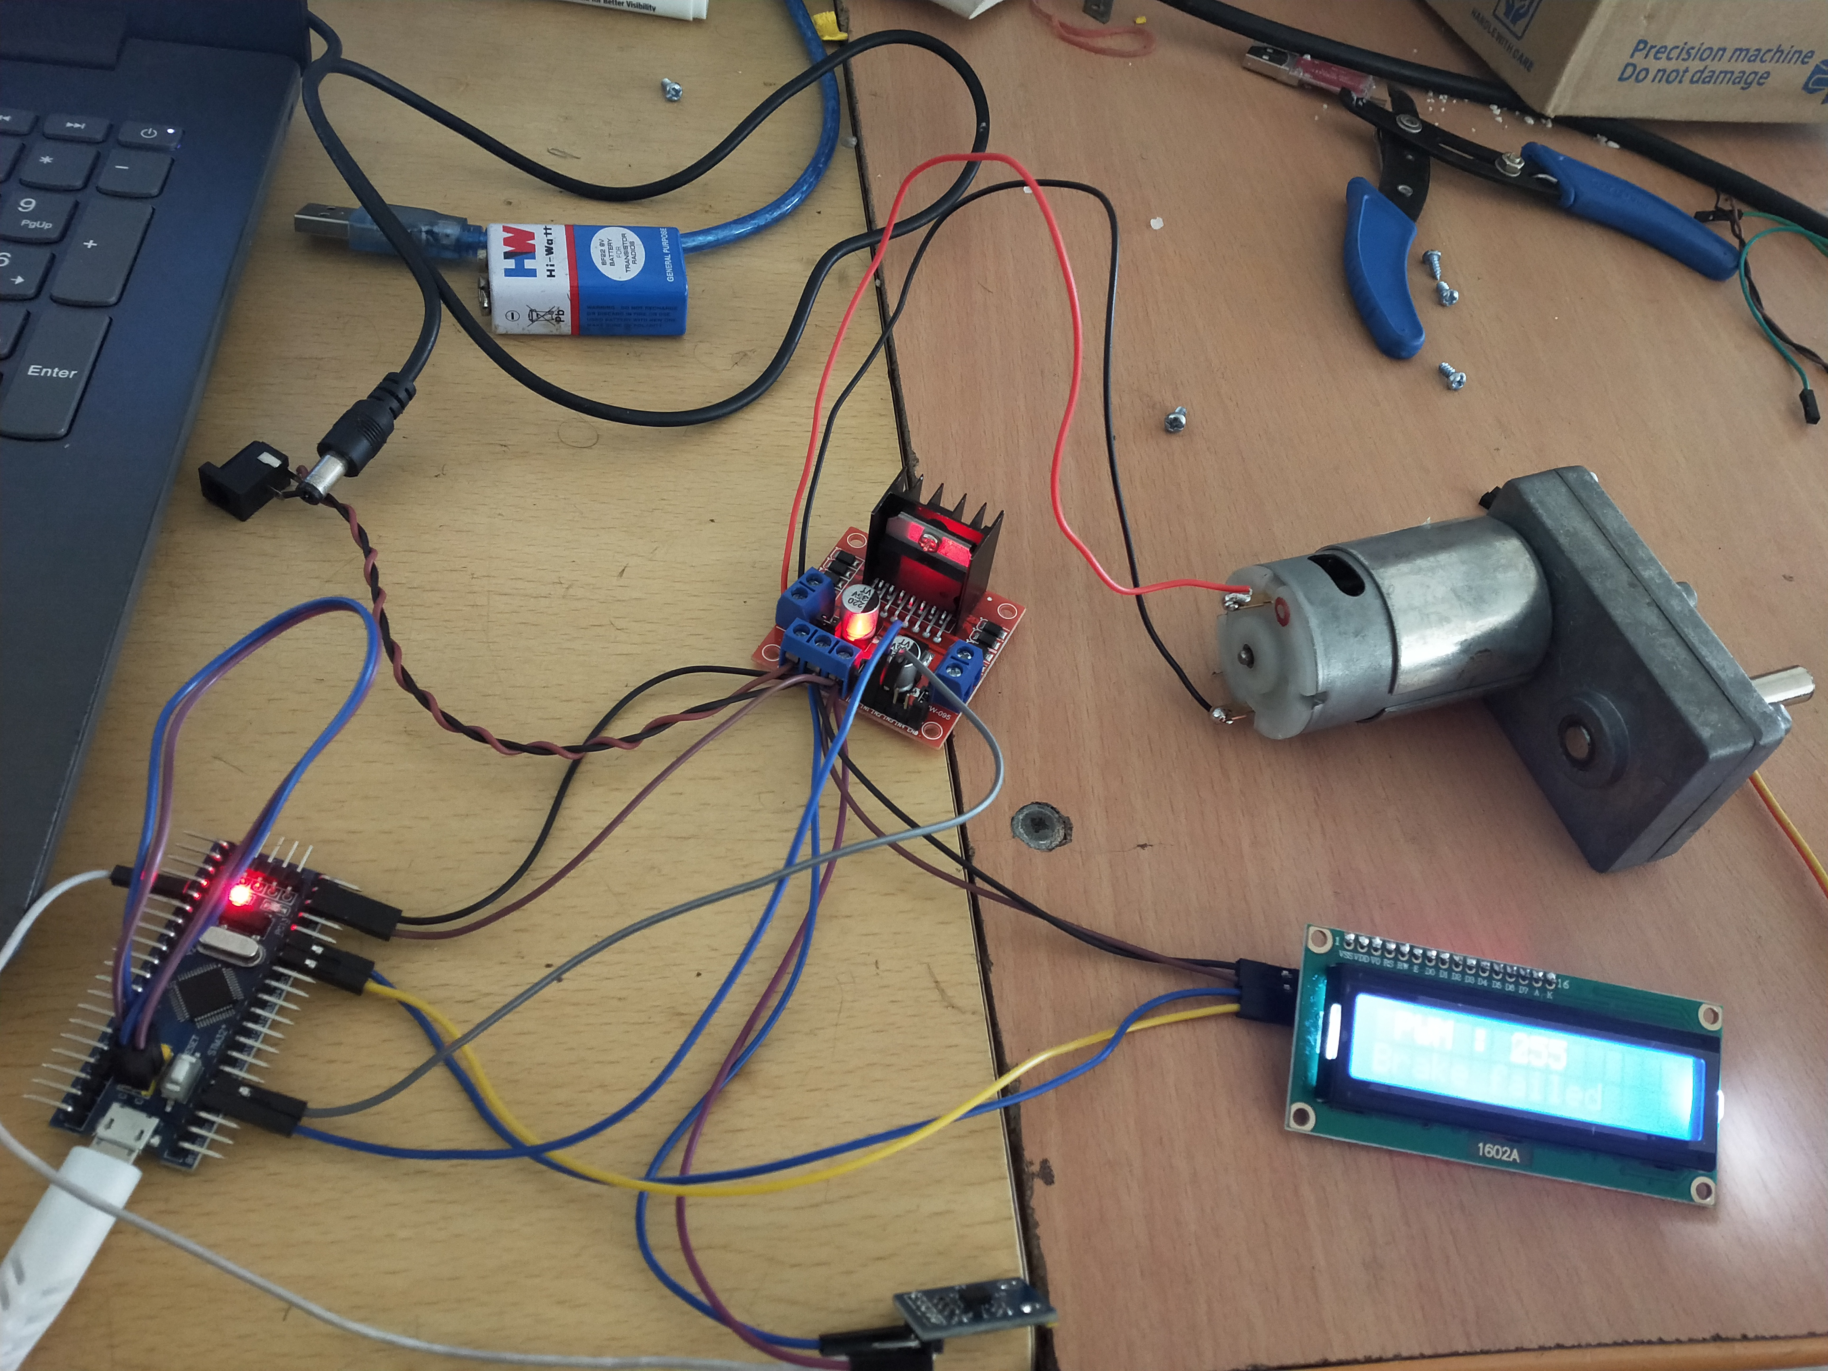
CIRCUIT OF THE PROJECT

Slide 16
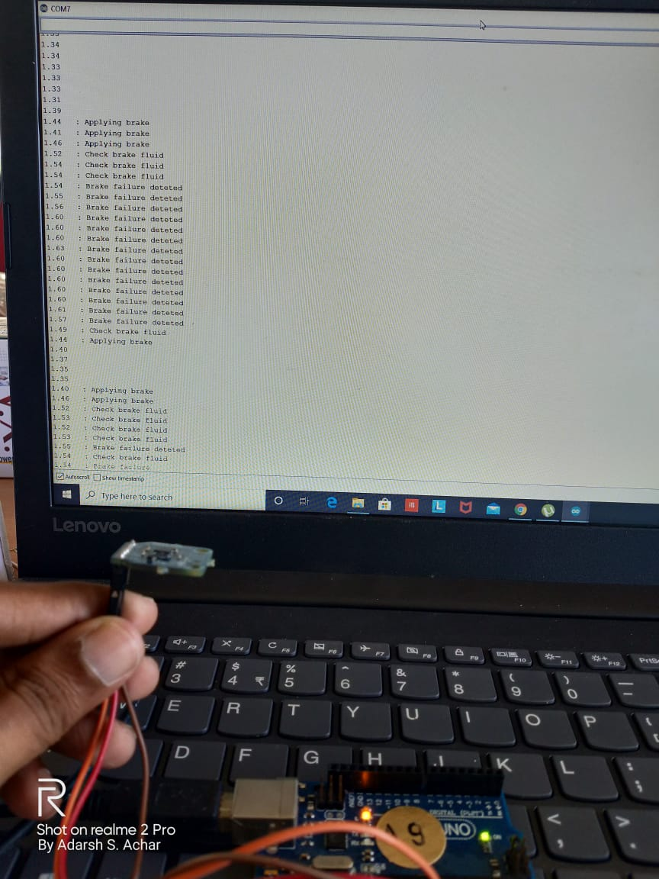
RESULTS
We will be obtaining the status of brakes in real time and brake failures are detected as soon as brake failure occurs. The result which is obtained is shown below:

Slide 17
The brake failure detection is done as soon as the brake failure occurs and is indicated in LCD display.
Various values of accelerometer voltages are monitored continuously and is compared with the normal braking conditions and brake failure conditions. The PWM voltage varies according to various braking conditions.
When the brakes are not applied, the PWM voltage is at maximum 255V. So, when the brakes are fully applied still brakes are not applied, then the brake failure is detected and the signal is passed to motor driver.
When the motor driver receives the detected signal from microcontroller, it reduces the PWM voltage to 0V and this 0V is sent to the DC motor.
Hence, the motor is stopped and the vehicle will gradually stop. All the conditions and warning messages are shown in LCD display, where while implementing, these messages will be displayed on dashboard.

Slide 18
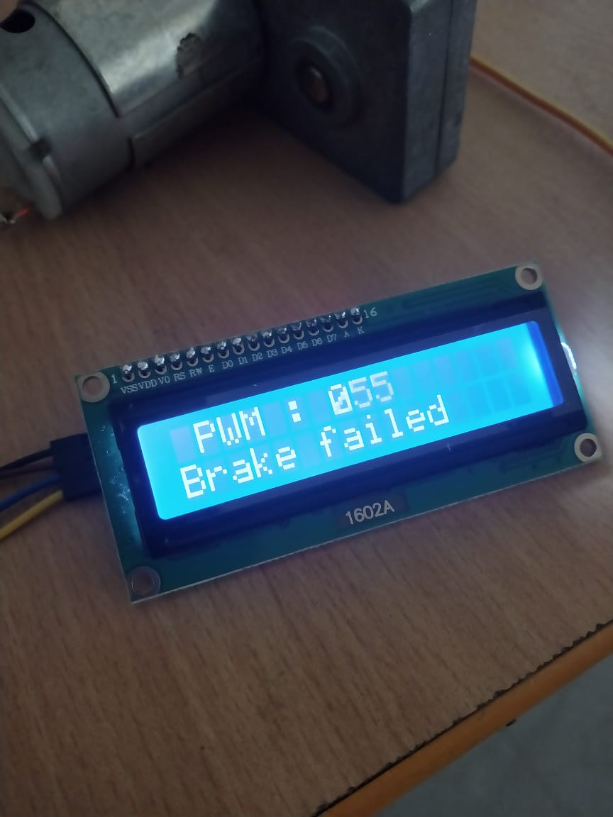
BRAKE FAILURE DISPLAYED ON LCD

Slide 19
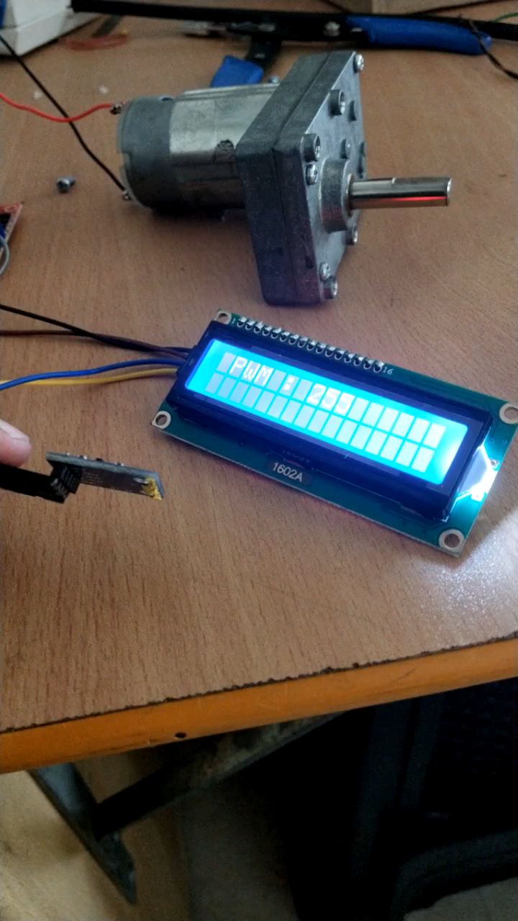
DEMONSTRATION OF PROJECT

Slide 20
REFERENCES
M. Grandone, M. Naddeo, D. Marra, G. Rizzo, “Development of a regenerative braking control strategy for Hybridized solar vehicle”, ScienceDirect, 2019, pp. 497–504 .
Fenyes , Balazs Nemeth , Peter Gaspar, “ A predictive control for autonomous vehicles using big data analysis”, ScienceDirect, 2019, pp. 191-196.
Akilan . M, Austin Ashley .S, Elayarajan.B ,Manikandan. M, Kalidas. K, “Fabrication of Brake Failure Detection and Acceleration Locking System in Automobiles”, International Journal of Engineering Research & Technology (IJERT), 2018, pp. 1-3.
Failure Indi G.VENKATA SIVA, Dr.B.CHANDRA MOHAN REDDY. “ Automobile Brake cator”, International Journal of Technical Innovation in Modern Engineering & Science Volume 4, Issue 7, July-2018 ,pp.322-326

Slide 21
D. Zhu, X. Wang, Y. Li and Y. Wang, “Research on Energy regenerative braking of electric vehicle based on functional safety analysis," IEEE 2017 2nd Asia-Pacific Conference on Intelligent Robot Systems (ACIRS), Wuhan, 2017, doi:10.1109/ACIRS.2017.7986117, pp. 326-330
Radhakrishnan Maske, Satesh Surwase, Balbhim Moharir, Vrushabh Mahajan ,Vijay Kedar5, Prof.Amol Adkine, “ Automatic Brake Failure Indicator and Braking System”, IJARIIE, volume-3-issue-3,2017, pp.2168-2172
Prof. Pandit Biradar , Jitendra Baravkar , Komal Bhujbal , Avi Bhapkar, “Automatic Brake Failure Detection with Auxilary Braking System ”, IJSART –volume 2 issue-3,March-2016,pp.1-5
S, Ko , C. Song , J. Park, J . Ko , I Yang and H. Kim, “Comparison of braking performance by electro-hydraulic ABS and motor torque control for in-wheel electric vehicle ,” 2013 World Electric Vehicle Symposium and Exhibition Barcelona,2013,doi-10.1109/EVS.2013.691491,pp.1-6

Slide 22
K. Sundareswaran, P. Sankar and P. S. R. Nayak, "Analysis on the failure of dynamic braking of capacitor-run induction motor supplied from half-controlled converter," 2012 IEEE International Conference on Power Electronics, Drives and Energy Systems (PEDES),Bengaluru,2012,doi:10.1109/PEDES,2012.6484447, pp.1-5

